Slide 1
PLANNER APP
By Marie Folau

Slide 2
PURPOSE OF MICROSERVICE
This microservice acts as a personal planner which enables the user to input their daily tasks and take down notes as a reminder of the upcoming tasks for that current day.
With ongoing duties needed to be fulfilled on a daily basis, this microservice will help assist individuals execute and keep track of the number of tasks and responsibilities they have listed.

Slide 3
Functionality & features of Microservice
Intake of user input such as the current date to enable user to list tasks set out for that day.
Able to store more than one set of tasks in microservice which allows user to input as many daily duties as necessary.
Enables user to update notes or tasks incase of errors made.
Stores data into H2 Database.

Slide 4
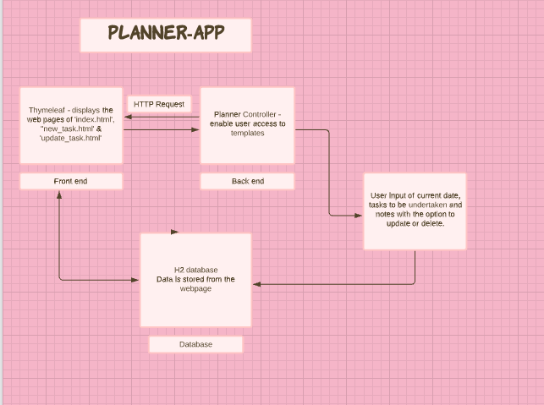
Planner App Diagram

